Slide 1
Assessing the Impact of Transportation Electrification on the Electric Grid
Malini Ghosal*, Samrat Acharya*, Travis B Thurber,
Allison M Campbell, Casey Burleyson and Yang Ou
*Power Systems Research Engineer
Notes:
Stock Image

Slide 2
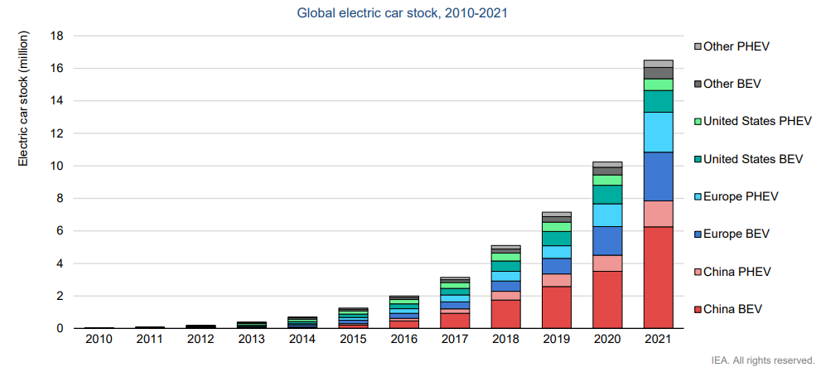
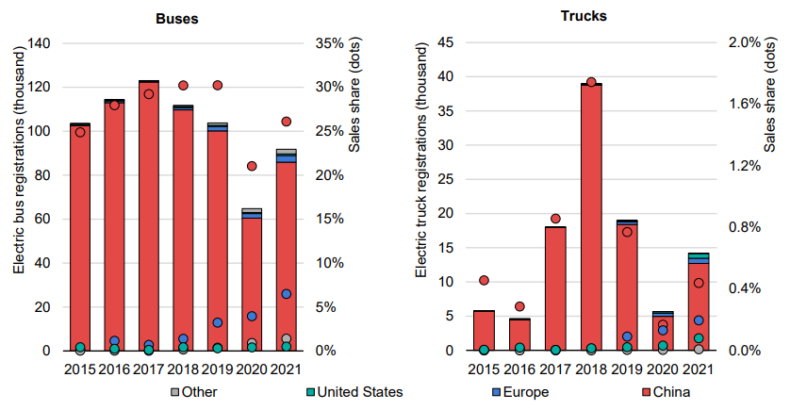
Electric Vehicle Growth
Fig: Global electric car sales, 2010-2021*
Fig: Global electric buses and trucks sales, 2015-2021*
EV market shares in 2021: Light Duty Vehicles (LDVs) – 9%, Medium Duty vehicles (MDVs) (buses, delivery vans) – 4%, Heavy Duty Vehicles (HDVs) ( heavy trucks) – 0.1%
Vehicle market share in US: LDVs -- 54.2%, MHDVs – 27.1 %**
Source: *Global EV Outlook 2022, IEA
Available at: https://iea.blob.core.windows.net/
Source: **Use of energy explained, Energy use for transportation
Available at: https://www.eia.gov/energyexplained/use-of-energy/transportation.php

Slide 3
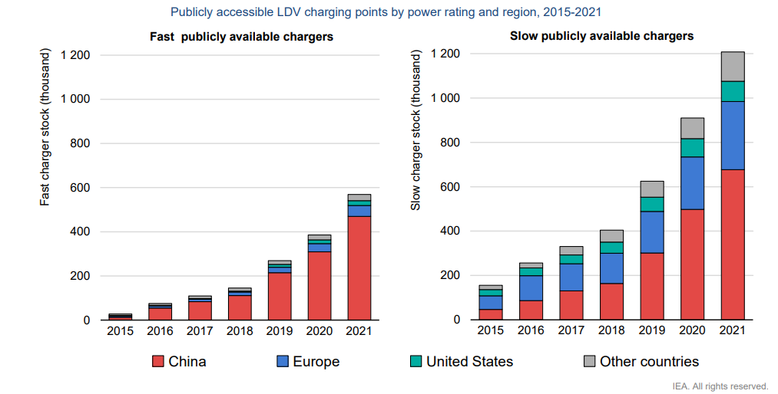
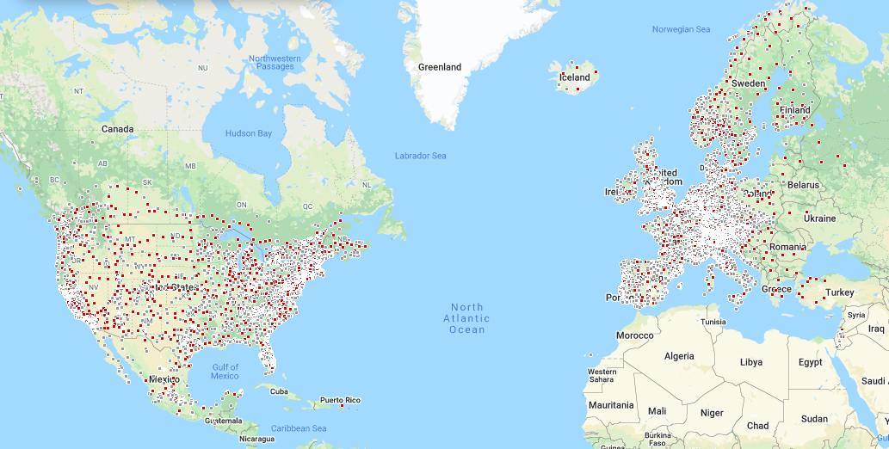
Growth of Electric Vehicle Charging Stations
Extreme Fast Chargers (xFC)
(500kW – 4 MW)
>100 kWh battery
<3 kW AC (L1)
<20 kW AC (L2)
DC Chargers: Anything above L2 (L3)
Now available 25 kW -350 kW
400 miles in single charge $≈0.5 hr$
Source: *Global EV Outlook 2022, IEA
Available at: https://iea.blob.core.windows.net/
Source: **Tesla Superchargers
Available at: https://www.tesla.com/supercharger
Fig: Global LDV public chargers, 2015-2021*
Fig: Tesla chargers**
Bipartisan Infrastructure Law building 500,000 chargers in US ( in next 5 years)
Requires changers to be 150 kW and above

Slide 4
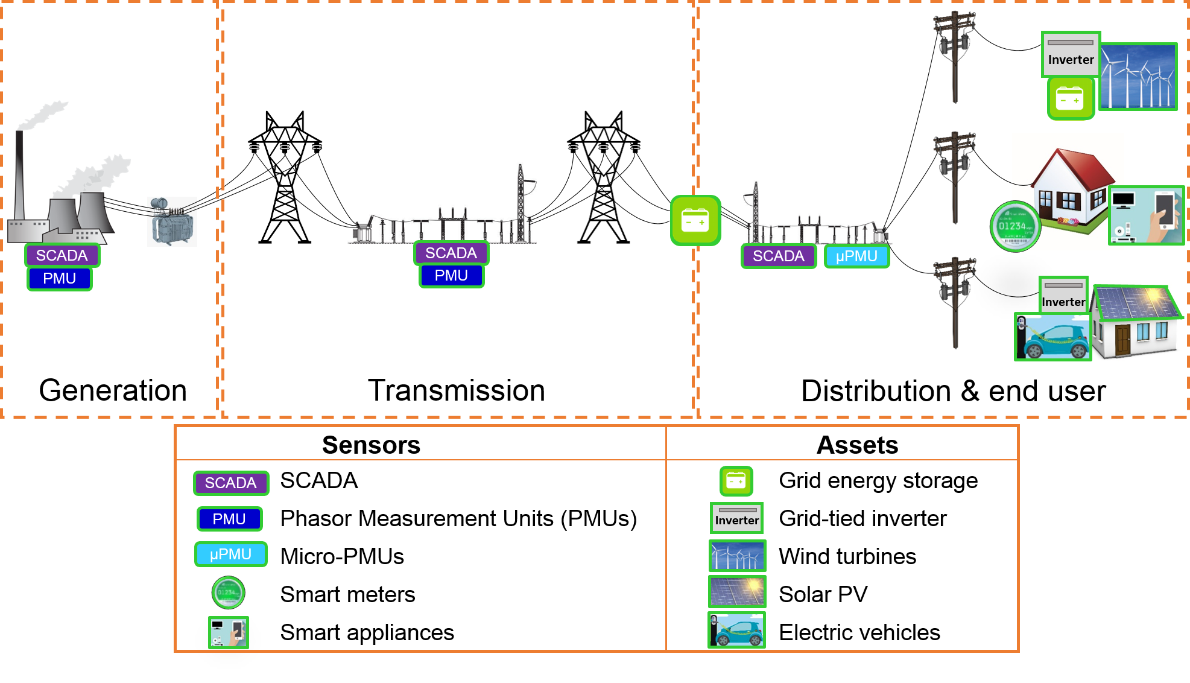
Electrical Grid

Slide 5
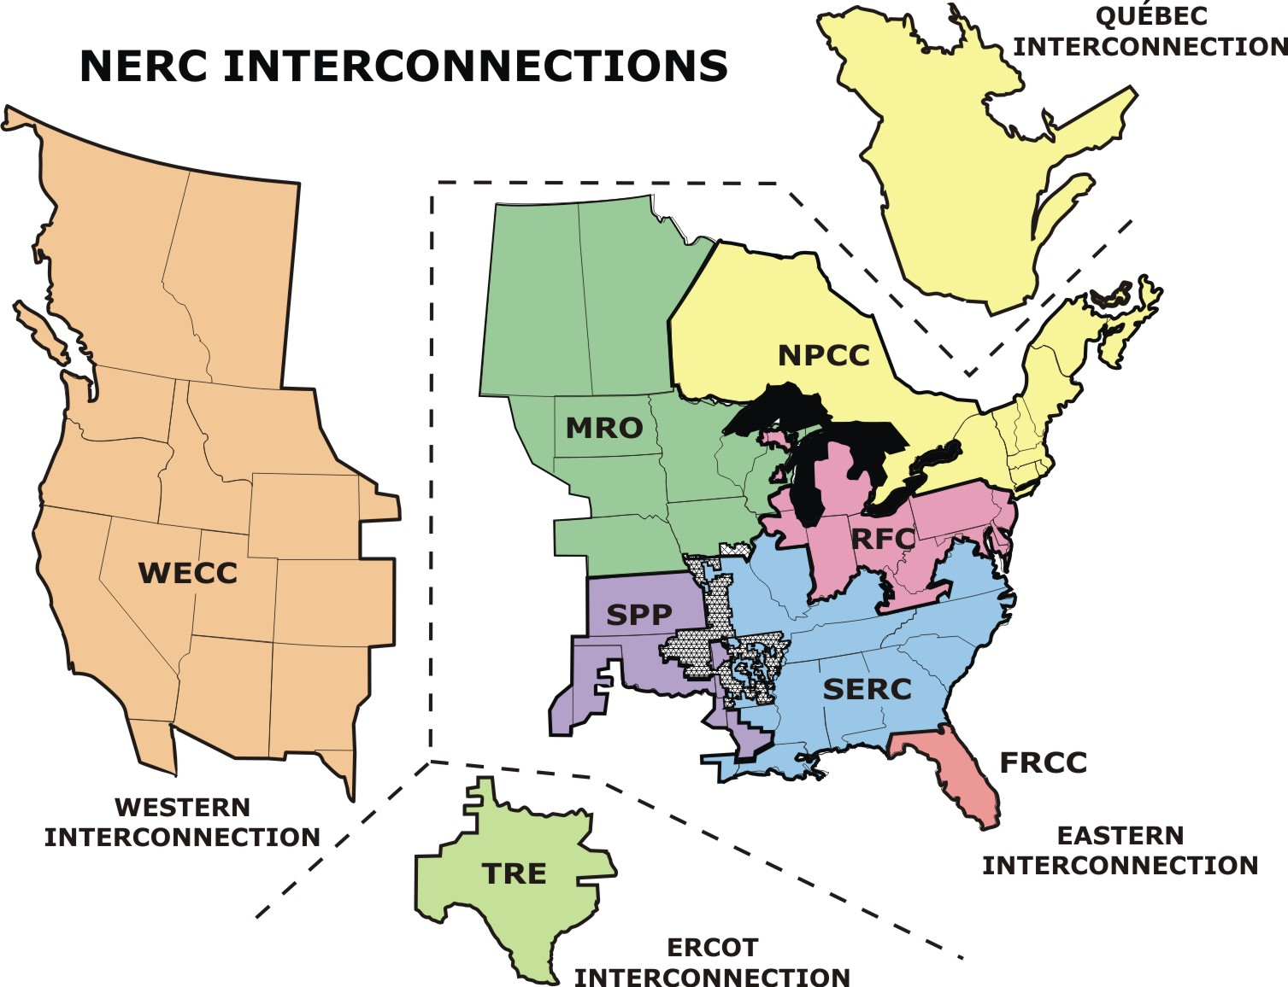
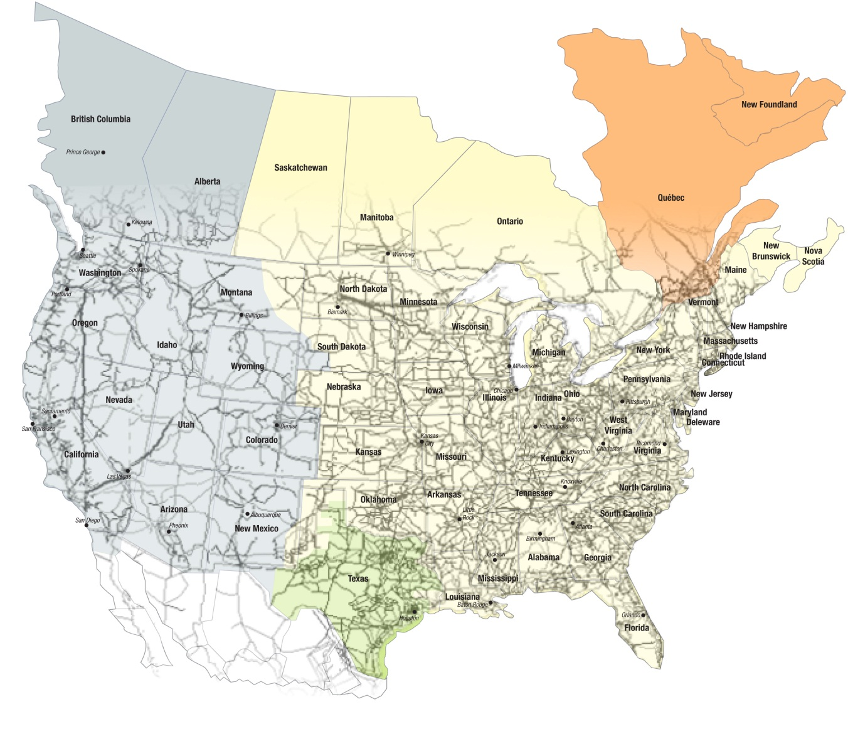
The North American Electric Power Grid
Regions of the North American Electric
Reliability Corporation (NERC)
The biggest machine!
Notes:
NAEPG is a

Slide 6
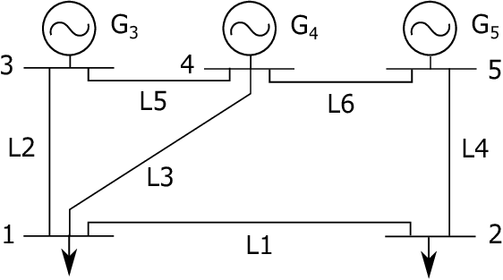



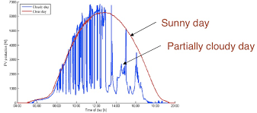

Assessing the impact of transportation electrification
Transmission system level.
Distribution system level (not covered here).
It is important to know, when and where charging is taking place.
Therefore, generating electric load shapes from transportation sector for future year is of importance.

Slide 7

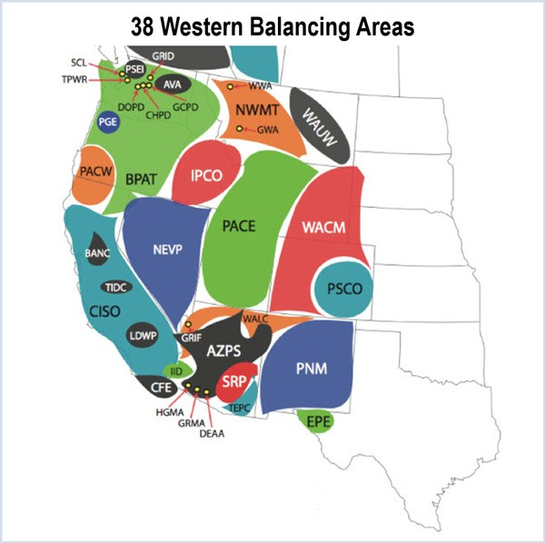
GODEEEP: Assess transportation electric load’s impact on transmission grid operation
Overall Project Goal: GODEEEP addresses the resilience implications of decarbonization for United States electricity system operations and impacts on environmental and energy equity.
Goal for transportation focus sub-problem
How much does the production cost increase?
Is there enough generation?
How is the fuel mix going be impacted?
Is there transmission congestion?
Assess various decarbonization scenarios- 2025-2050 in the WECC.
Downscaling transportation electric load from multi-sector dynamics model for decarbonization pathways.
Generate transportation load profile (hourly) at balancing area level.
Notes:
Grid Operations, Decarbonization, Environmental and Energy Equity Platform

Slide 8
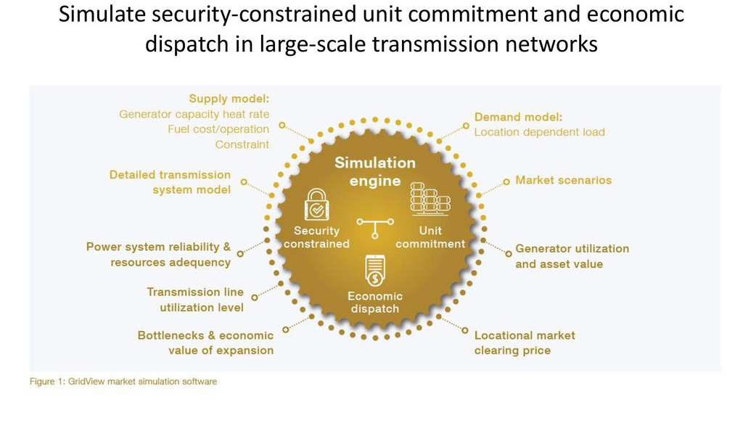
Production cost modeling: market simulation software (GridView)
Inputs:
Hourly load profiles
Generation resources, heat rates
Transmission system topology
Output:
Generation utilization
Line utilization
Locational marginal price
Source: https://www.hitachienergy.com/

Slide 9


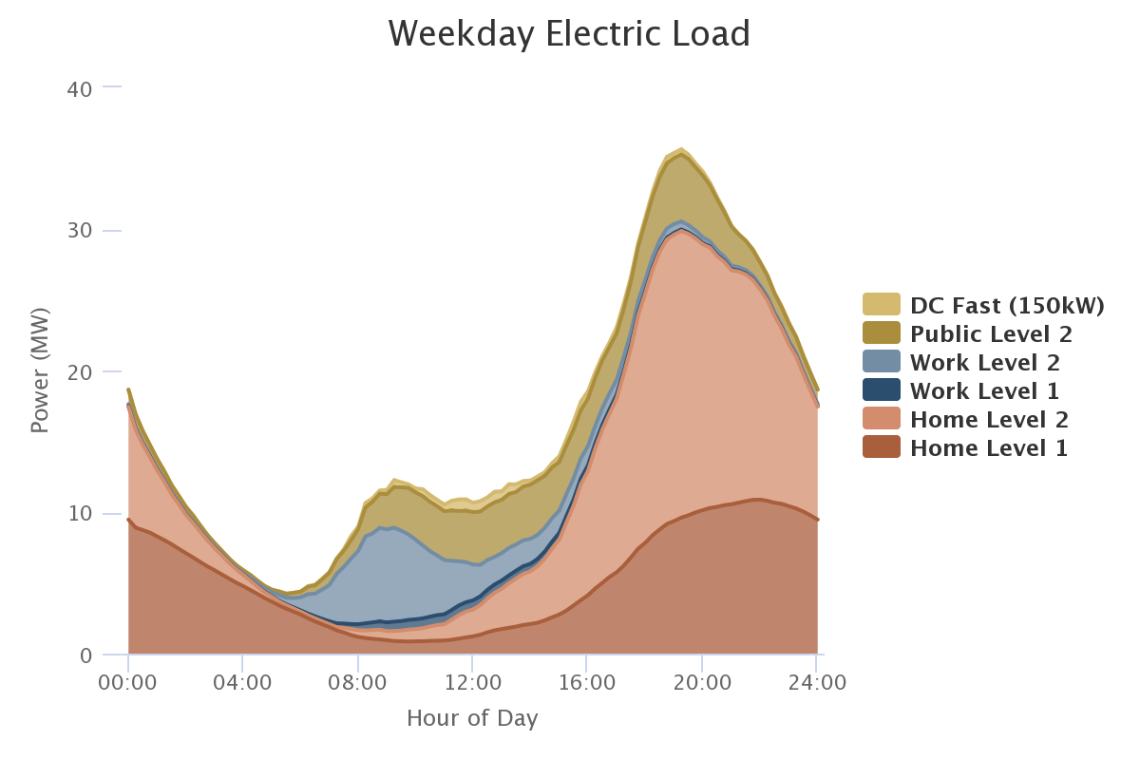
Modeling transportation load for the future grid
GCAM
Multi-sector dynamics model
A coarse model giving state level yearly energy use
WRF
Meso-scale weather prediction numerical model
Transportation load down-scaling
Hourly load profile at balancing
authority level
Impact analysis
Nodal production cost
Locational marginal cost
Resource adequacy
Transmission congestion
Generation mix
Total Electric Load Model
Predicting the non-transportation electric load growth (climate informed)
CERF
identifies feasible, site-specific locations for individual new power plants (renewable and non-renewable)
1 km^2 spatial resolution
GridView- Production cost model
Runs unit commitment problem with future grid topology, load and generation scenario

Slide 10
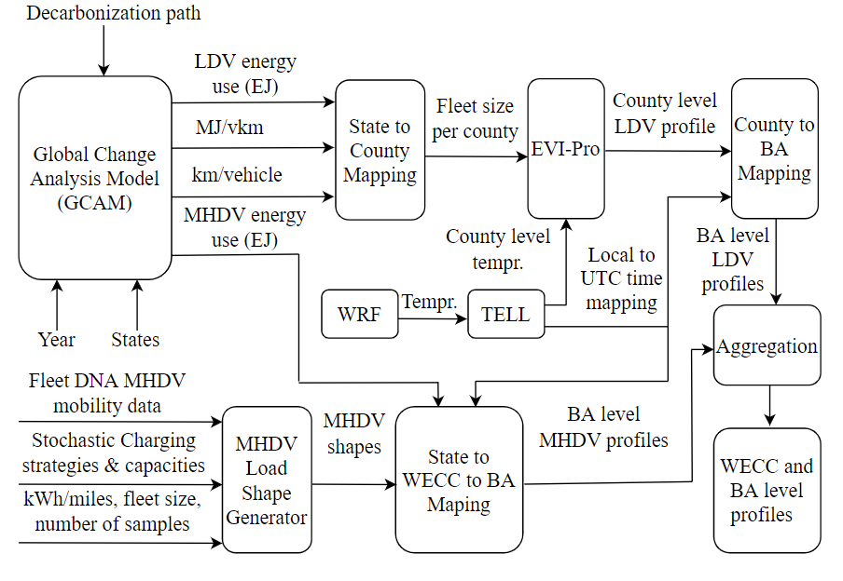
Transportation Load Downscaling Method

Slide 11
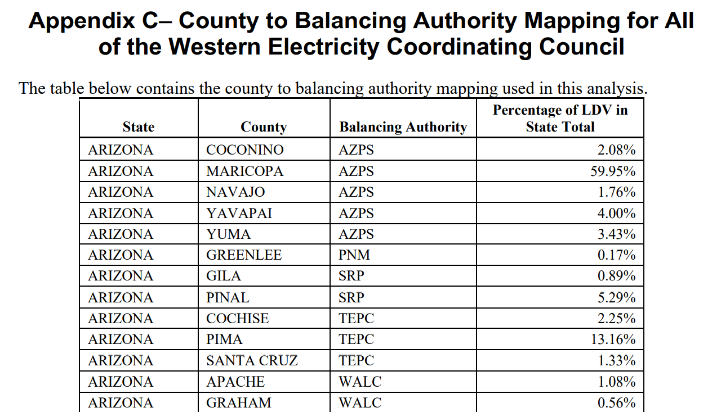
Spatial Disaggregation and Fleet Size Assumption for LDV
State to county disaggregation: The county-specific LDV registration data for 2019 were used as a reference point to identify what percentage of the total number of vehicles in a state was registered in every county.
County to BA level aggregation
County level mean temperature information is used.
Fig. County level EV adoption from vehicle registration data *
[1] https://www.atlasevhub.com/materials/state-ev-registration-data#data
BA Level energy
Number of EVs in a fleet
*Kintner-Meyer, M., et al. Electric vehicles at scale–phase I analysis: High EV adoption impacts on the western US power grid. No. PNNL-29894. 2020.
BA Level vkm
Fig. Fleet Size Assumption

Slide 12
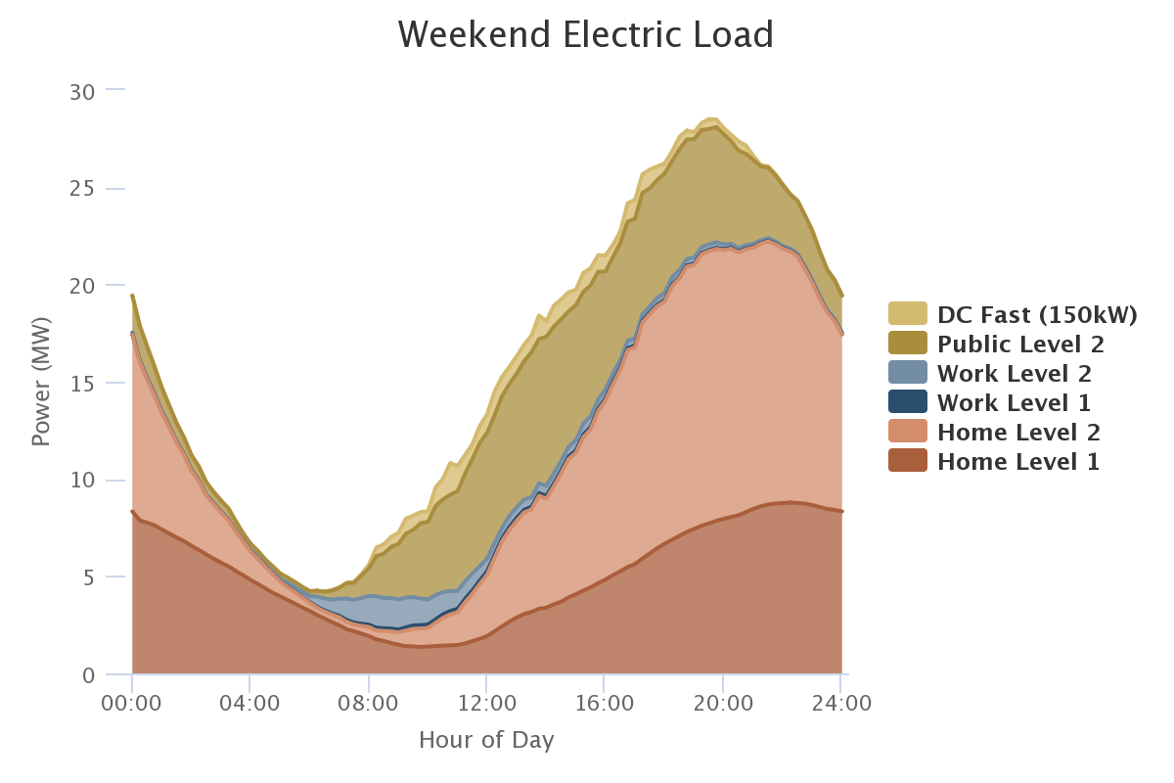
Sample LDV Load Shape from EVI Pro*
*Wood, Eric W., et al. Charging electric vehicles in smart cities: An EVI-Pro analysis of Columbus, Ohio. No. NREL/TP-5400-70367. National Renewable Energy Lab.(NREL), Golden, CO (United States), 2018.

Slide 13
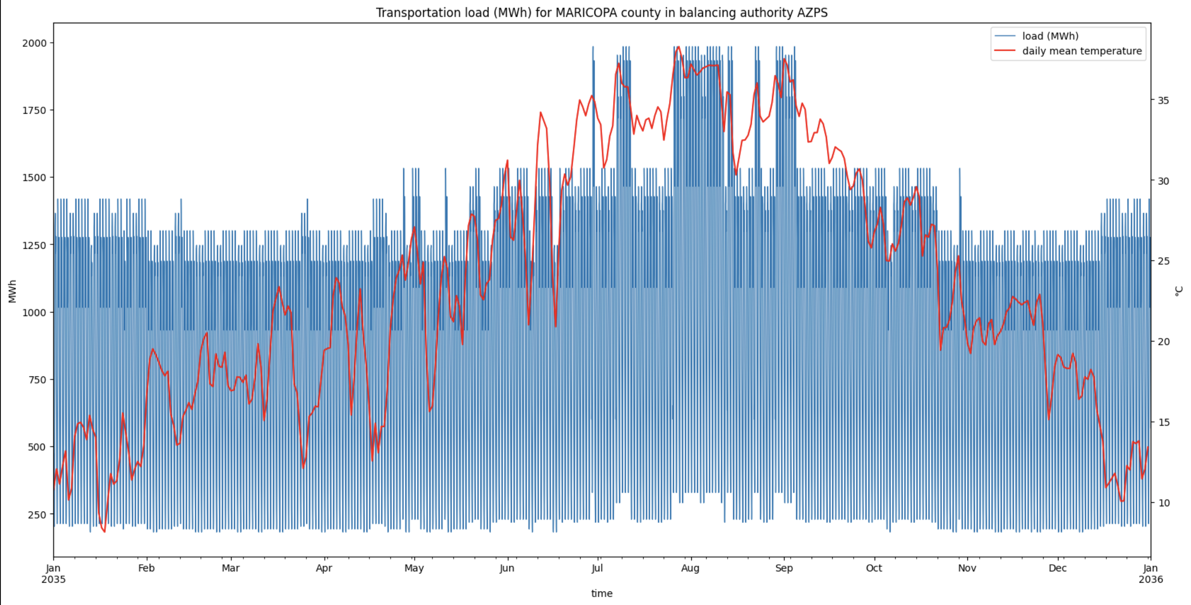
Sample BA/County Level LDV Shape
As we can see, higher temperature during Arizona summer is impacting the battery charging/discharging model and therefore, more energy is consumed.
No assumption of month-to-month variability in total vehicles miles traveled is assumed.

Slide 14
Transportation Load Downscaling Method

Slide 15
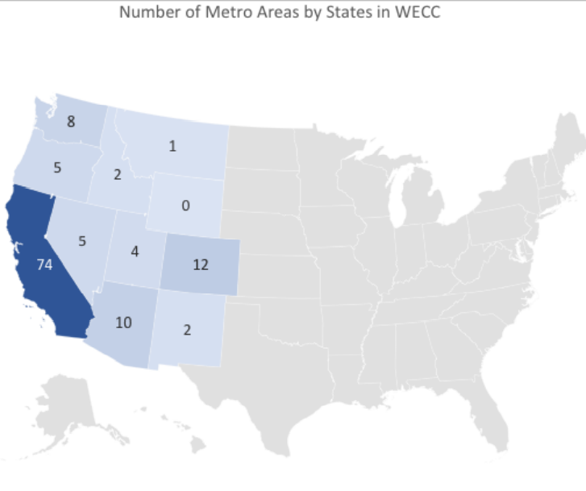
MDVs & HDVs- Spatial Distribution in WECC
Cities and jurisdictions where clean air regulations (non-attainment zones) may drive zero-emission vehicle policies.
Sharing algorithm: above criteria + cities with population above 100,000.
The total number of electric MDVs was then applied based on a proportional percentage of the population of the 313 cities.
The total number of electric MDVs for the WECC are 70,000 or about 35% of the assumed national electric MDV fleet of 200,000.
Kintner-Meyer, M., et al. Electric vehicles at scale–phase I analysis: High EV adoption impacts on the western US power grid. No. PNNL-29894. 2020.

Slide 16
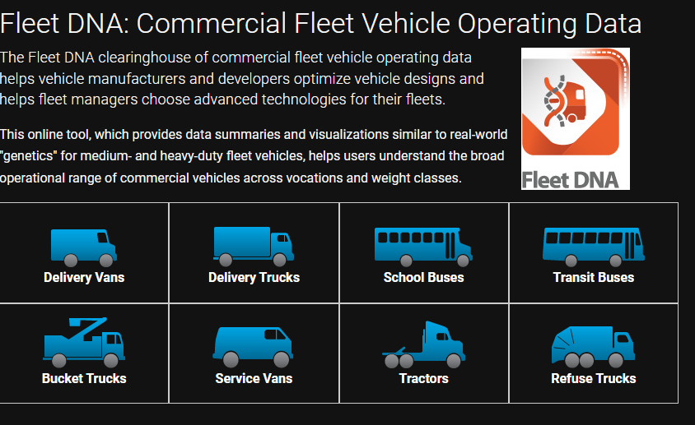
Dataset Used for MDVs and HDVs
FleetDNA dataset for driving pattern of return-to-base commercial low-duty, medium-duty and heavy-duty vehicles is used: start time, stop time, and vehicle miles travelled.
The data is discontinuous time-series for years: 2008, 2012, 2014.
The data is anonymously collected for vehicles in US. So, no direct mapping for vehicles in WECC
The FleetDNA data is used to find distribution of start time, stop time, and vehicle miles travelled.
Used for developing charging profiles for MDVs and HDVs.
Vehicles | Classes
Delivery Vans | 3-6
Delivery Trucks | 3-7
School Buses | 3-6
Transit Buses | 7 & 8
Bucket Trucks | 3-7
Service Vans | 2 & 3
Tractors | 7 & 8
Refuse Trucks | 8
Type | Class | GVWR
LDV | 1 & 2 | <10k lbs
MDV | 3-6 | 10k-26k lbs
HDV | 7 & 8 | >26k lbs
FleetDNA Commercial
Vehicles**
Based on Us Federal Highway
Administration* (AFDC)

Slide 17
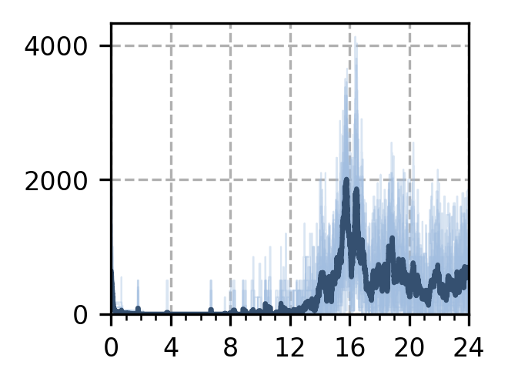
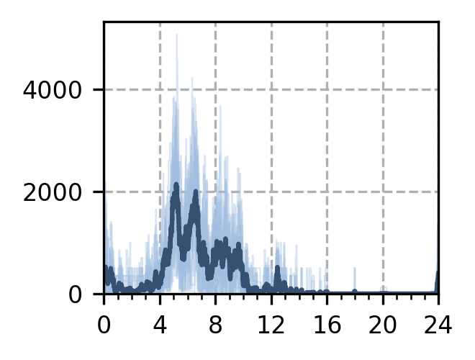
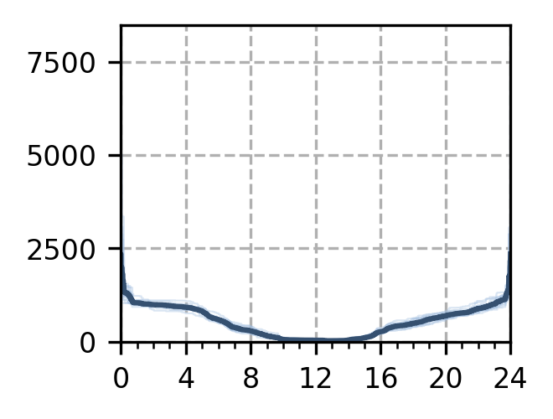
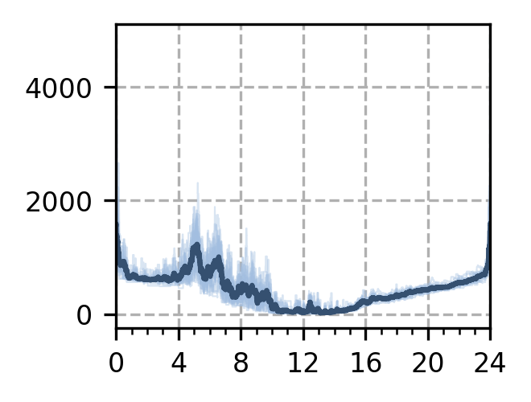
MDV Load Shape Generation
kw_list = [50, 125, 250, 350, 500, 1000]
kw_weights = [5, 5, 10, 40, 40, 0]
Immediate
Delay
Min Power
Combined
Power, KW
Low Bound Peak Demand (kW): 2250
Average Peak Demand (kW): 2005.0
Upper Bound Peak Demand (kW): 4125
Low Bound kWh/operating day: 5993.31
Average kWh/operating day: 6523.56
Upper Bound kWh/operating day: 7048.02
Low Bound Peak Demand (kW): 2225
Average Peak Demand (kW): 2143.75
Upper Bound Peak Demand (kW): 5075
Low Bound kWh/operating day: 5993.31
Average kWh/operating day: 6523.56
Upper Bound kWh/operating day: 7048.02
Low Bound Peak Demand (kW): 1171.99
Average Peak Demand (kW): 2350.86
Upper Bound Peak Demand (kW): 8082.45
Low Bound kWh/operating day: 12152.29
Average kWh/operating day: 13096.5
Upper Bound kWh/operating day: 14083.84
Low Bound Peak Demand (kW): 1444.98
Average Peak Demand (kW): 1593.67
Upper Bound Peak Demand (kW): 4871.47
Low Bound kWh/operating day: 9688.7
Average kWh/operating day: 10467.33
Upper Bound kWh/operating day: 11269.51
Combined = 0.2* immediate + 0.3* delay + 0.5 min power

Slide 18
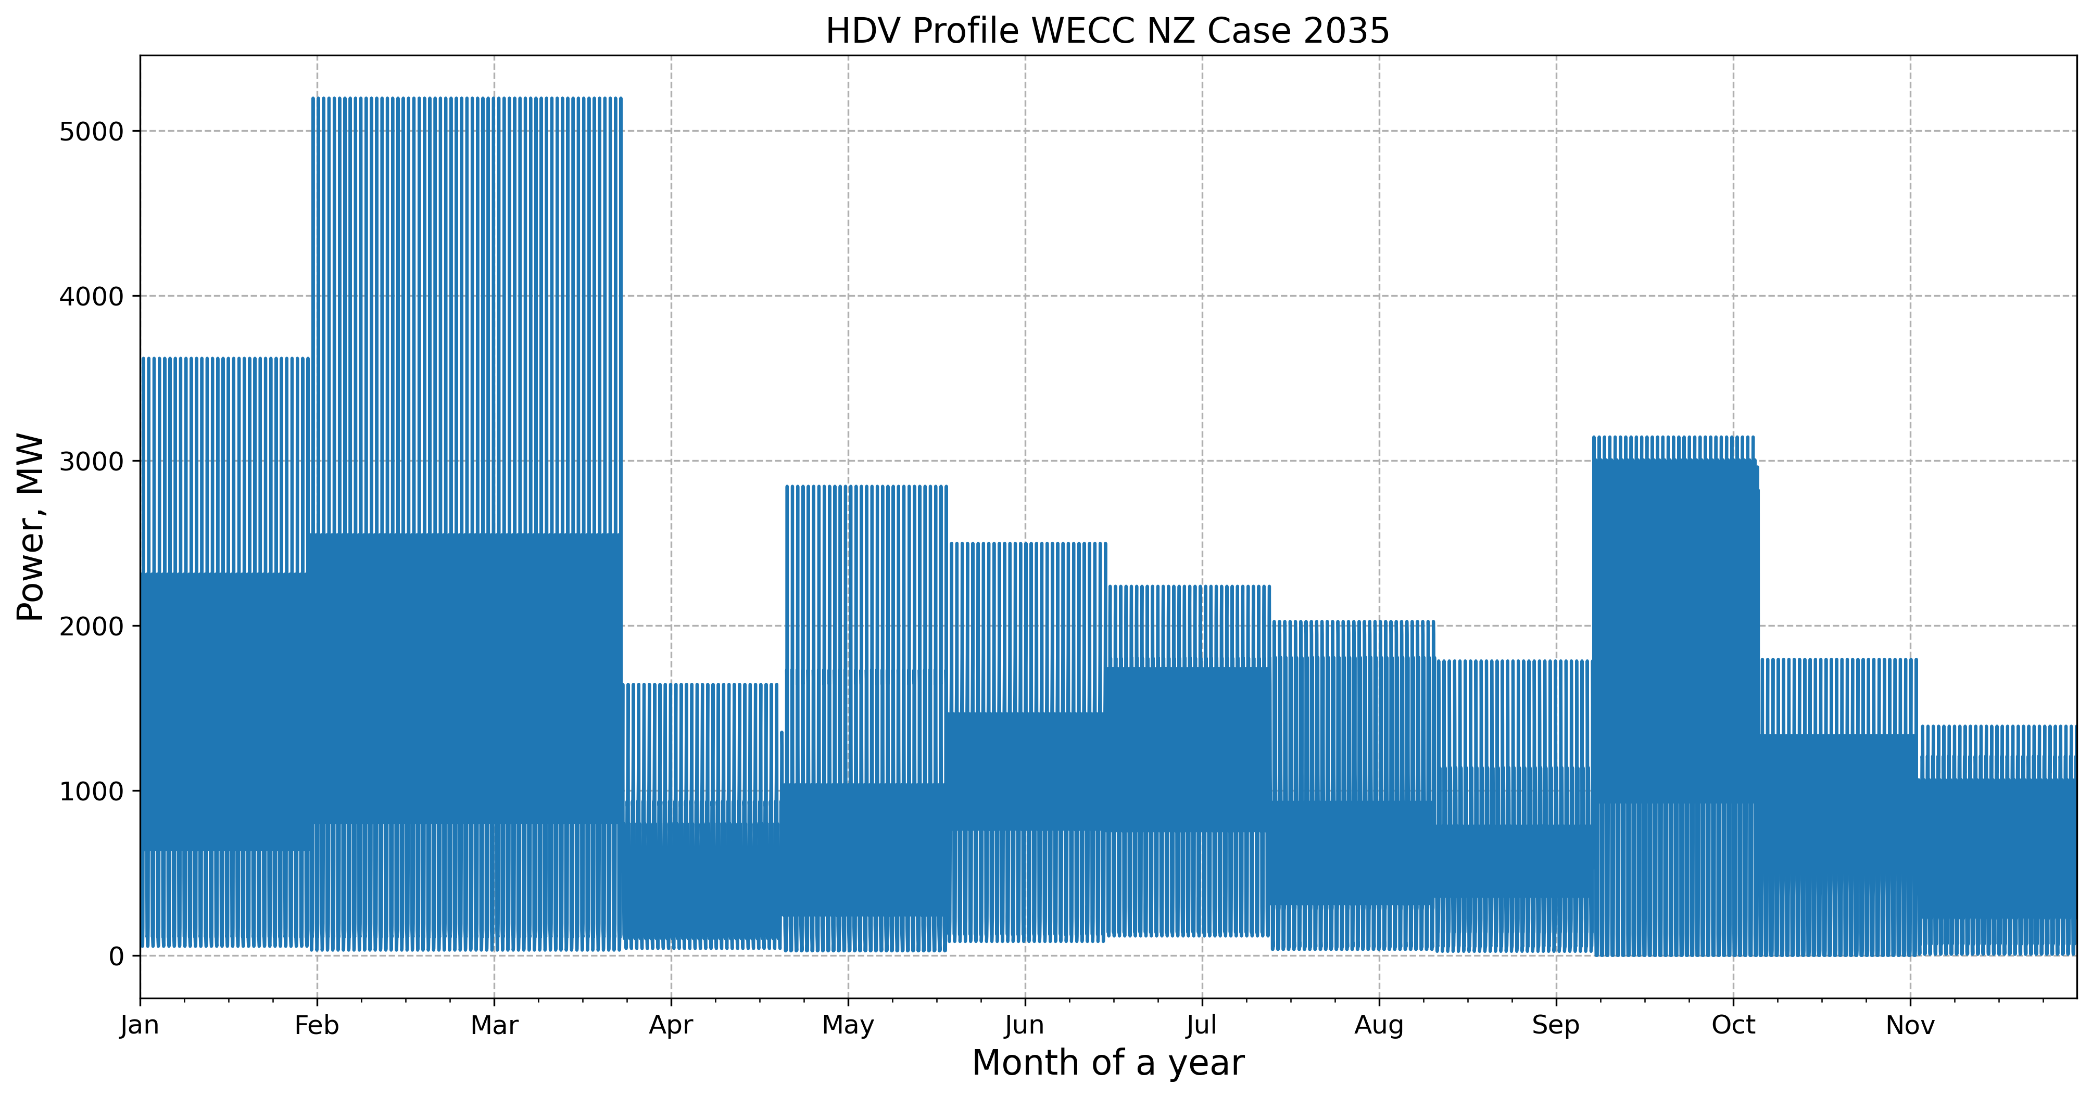
Time-Series MDV Load in WECC
kw_list = [50, 125, 250, 350, 500, 1000]
kw_weights = [5, 5, 10, 40, 40, 0]
Combined = 0.2* immediate + 0.3* delay + 0.5 min power

Slide 19
Conclusion
Work in progress.
The presentation outlines the methodology to accurately assess impact of transportation load on the decarbonized, future transmission grid.
Business-as-usual and net zero scenarios are assessed for a hot climate scenario.
The study will inform any resource adequacy, production cost, operational impact of rapid transportation electrification for various decarbonization scenario.
The method could be adapted for any other footprint beyond WECC.

